Slide 1
Small White Matter Lesion Detection in Cerebral Small Vessel Disease
Mohsen Ghafoorian^{a,b}, Nico Karssemeijerª, Inge van Uden^{c}, Frank-Erik de Leeuw^{c}, Tom Heskes^{b}, Elena Marchiori^{b} and Bram Platelª
ª Diagnostic Image Analysis Group, Radiology Department, Radboudumc, Nijmegen, the Netherlands ^{b} Institute for Computing and Information Sciences, Radboud University, Nijmegen, The Netherlands
^{c} Donders Institute for Brain, Cognition and Behaviour, Department of Neurology, Radboudumc, Nijmegen, The Netherlands

Slide 2
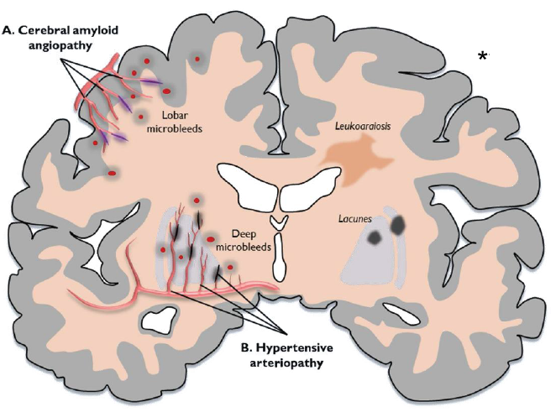
Small Vessel Disease
The term cerebral small vessel disease (SVD) refers to a group of pathological processes with various causes that affect the small arteries of the brain
Prevalent in elderly people
Symptoms are disturbances in:
Cognition
Motor
Mood
* A. Charidimou et al., Front. Neur. 2012
Notes:
Small vessel disease is indeed a process that affects the small arteries in the brain and as the result the blood cells can not feed some of the cells in the brain.
SVD is a normal result of aging and is a prevalent disorder in elderly people. This makes it a growing concern for the current century for the aging societies.
SVD patients usually complain about mild
Patients usually complain about mild cognitive, motor and mood disturbances. These symptoms are either because of complete infarction that are called lacunar syndromes or incomplete infarction that are indeed some changes in white matter of the brain which we call white matter lesions, or white matter hyperintensities.

Slide 3
Small Vessel Disease
Only in some cases SVD leads to
Cognitive impairment
Motor impairment
Dementia
Parkinsonism
White matter lesions: a common observation on SVD patients
To this end studies are being conducted to investigate cognitive and motor performance in relation to WML locational distribution, total load and progress.
Including the RUNDMC* study.
* van Norden et al. BMC Neurology 2011
Notes:
Bad news is in a small proportion of SVD patients, it will lead to more severe neurological disorders namely cognitive and motor imparment, dementia and Parkinsonism.
Since white matter lesions are one of the most important factors describing SVD, there are studies investigating cognitive and motor performance in relation to wml properties such as total volume, locational distribution and progress in WMLs.
One of these studies is RUNDMC, conducted by researchers in Neurology department of Radboudumc.

Slide 4
The RUNDMC Study
Cohort follow up study:
503 SVD patients
Including
Cognitive, motor tests
Brain MR images
….
Time series:
Baseline: 2006
Follow up:
2011
2015
Notes:
To briefly tell you about the RUNDMC, it is a cohort follow up study of more that 503 svd patients and it includes several investigation of brain and cognition status of the patients including cognitive and motor tests and Brain MR images.
This data comes in a time series, so the baseline was performed in 2006, the first follow up in 2011 and the second follow up is currently on the fly.
They manually annotated the white matter lesions in the baseline scans and asked us to perform automated detection of WMLs on the follow up series.

Slide 5
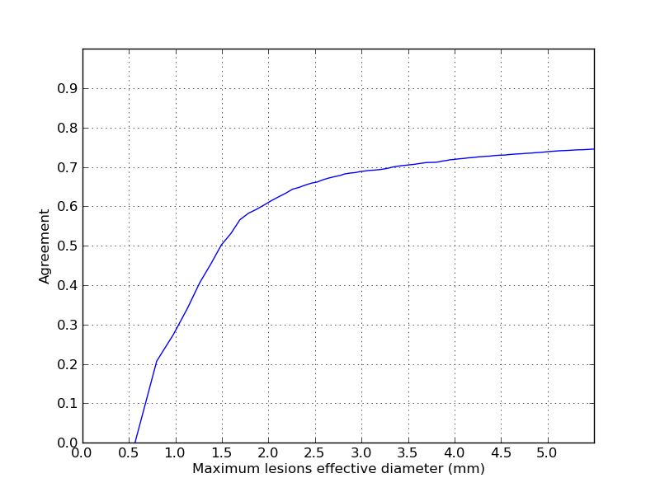
Automated Quantification of WML
Problems with manual white matter lesion annotation:
Very time consuming
Subjective
Prone to miss small WMLs
9 months!
Notes:
Of course they could repeat the process for the follow up data as well. But basically there are several problems with manual annotation of WMLs:
First it a laborious, time consuming task, at the same time, it subjective and human experts are prone to miss small white matter lesions.
To justify these claims I would like to disclose some facts about the baseline WML annotations:
The manual annotation of the cases took them 9 months.
Regarding the two other reasons please take a look at this graph that shows the agreement between the two users based on maximum lesion sizes:
We considered R1 agrees with an annotated lesion of R2 if only one of the voxel in the lesion is somewhere in the annotations of the R1!
Although it is a pretty loose criterion this observation revealed that the readers rarely agree on smaller lesions. For example for the lesions that their effective diameter is smaller
that 1.0 mm, they completely disagree on 70% of lesions and for those lesions. This agreement is only 50% on lesions with effective diameter smaller than or equal to 1.5 mm

Slide 6
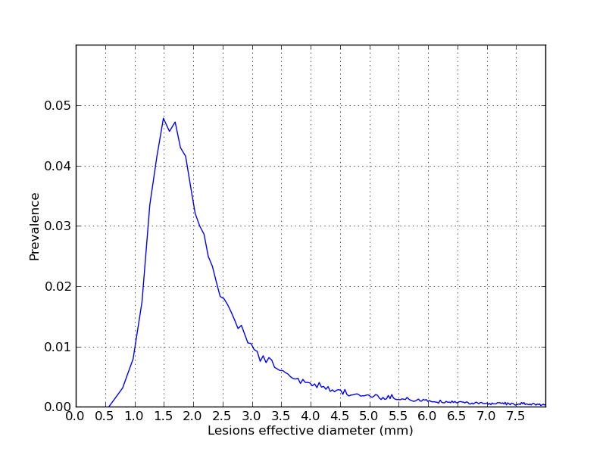
Motivation - Why small WMLs are important?!
...
To this end studies are being conducted to investigate cognitive and motor performance in relation to WML
locational distribution
,
total load
and
progression.
Notes:
So far you might have been convinced that automated detection of WMLs is almost a must for large dataset and the it is the case that this task is pretty subjective specially on smaller lesions.
But the more important question is why should we care about accurate detection of small wmls at all?
To discuss about it, please notice the another diagram that we calculated from our dataset of SVD patients, which shows the distribution lesions based on their size:
As you see, there are actually many lesions in small size, for example more than 60% percent of lesions have effective diameter smaller that 3 mms.
And if I flash back to an earlier statement about the studies that want to investigate the relation of WML characteristics with some neurological disorders, they can much better assess locational distribution and progress of WMLs in time series if a better detection of these small WMLs is available. Also the estimation of total WML load would be more accurate given the fact that 15% of total wml volume is consisted by small wmls (smaller that 3 mms in effective diameter)

Slide 7
Purpose
Development of a voxel based CAD system to detect small white matter lesions as accurate as possible.
Notes:
Bad news is in a small proportion of SVD patients, it will lead to more severe neurological disorders namely cognitive and motor imparment, dementia and Parkinsonism.
Since white matter lesions are one of the most important factors describing SVD, there are studies investigating cognitive and motor performance in relation to wml properties such as total volume, locational distribution and progress in WMLs.
One of these studies is RUNDMC, conducted by researchers in Neurology department of Radboudumc.

Slide 8
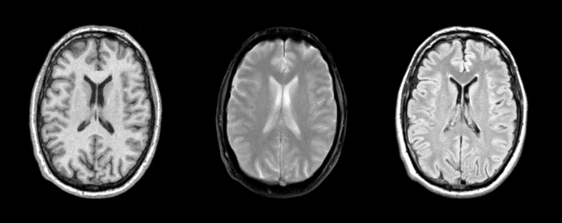

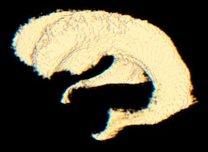
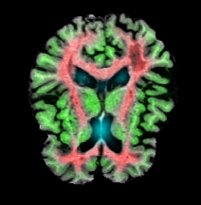

Overview
Preprocessing
Features
Training
Evaluation
Data
Notes:
To start a little bit about our methodology, First of all I have to mention that we stablished a voxel classifier that follows this standard pipeline for an image analysis task.

Slide 9
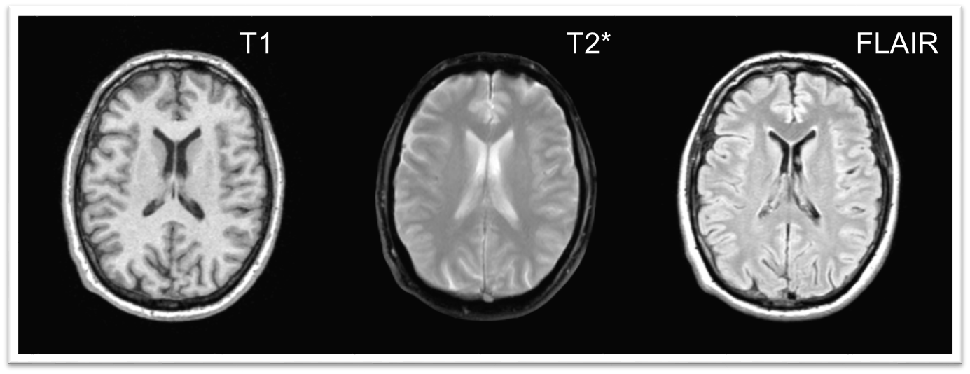
DATA
RUNDMC study:
503 SVD patients
1.5 Tesla MRI scanner (Magnetom Sonata, Siemens )
T1 (TR/TE/TI 2250/3.68/850 ms FA 15°, voxel size 1.0×1.0×1.0 mm)
FLAIR (TR/TE/TI 9000/84/2200 ms, voxel size 1.0×1.2×5.0 mm, 1 mm gap)
T2* (TR/TE 800/26 ms, voxel size 1.0×1.3×5.0 mm, 1 mm gap)
Notes:
About the acquired data, I have already introduced the RUNDMC for you, here are some more details about the imaging protocols: It consists of more that 500 hundered SVD patients that makes it an exceptionally large dataset compared to other similar datasets, but the drawback is the fact that they made use of a 1.5 T scanner that scanned T2* and FLAIR images with 6 mm thickness slices. The resulting partial volume effect will make the small WML detection a challenging task.

Slide 10
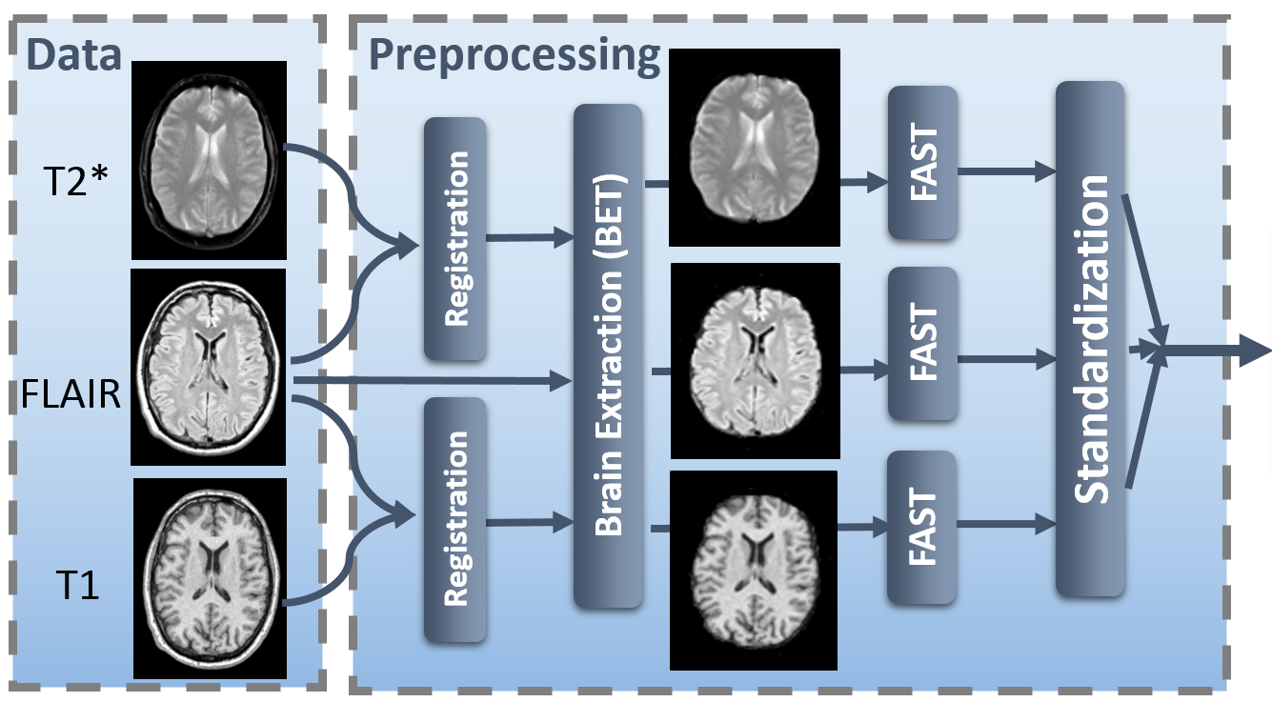
Preprocessing: A Bird’s Eye View
Notes:
Here we see an overall view of the Preprocessing steps to make the raw images ready for feature extraction

Slide 11
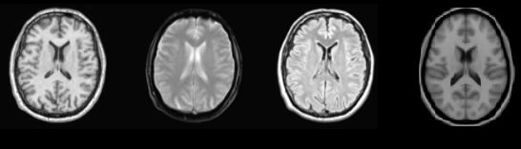
Preprocessing: Registration of Multimodal Patient Data
T1 and T2* volumes registered to FLAIR image using mutual information registration with tri-linear interpolation using FSL-FLIRT*
Non-linear registration from patient space to MNI atlas space using FSL-FNIRT*.
FLIRT
FNIRT
T1
T2*
FLAIR
MNI 152
FLIRT
* M. Jenkinson et al., Med. Image Anal. 2001
Notes:
First due to possible movement of patients during acquiring of the different scans, we perform a linear registration of T1 and T2* to FLAIR scan using FSL-FLIRT. We also perform a non-linear registration form patient space to MNI space.

Slide 12
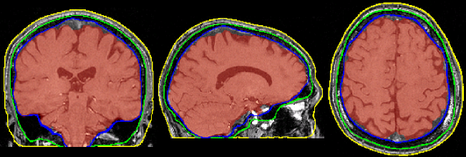
Preprocessing: Brain Extraction
FSL Brain Extraction Tool* (FSL-BET) was used to remove the skull
The T1 scan was used for this, as it has the highest resolution
* J. Mazziotta et al., J. Am. Med. Inform. Assoc. 2001
Notes:
Then we have to strip the skull and for this the Brain Extraction Tool was used on T1 scans because they have the highest resolution

Slide 13
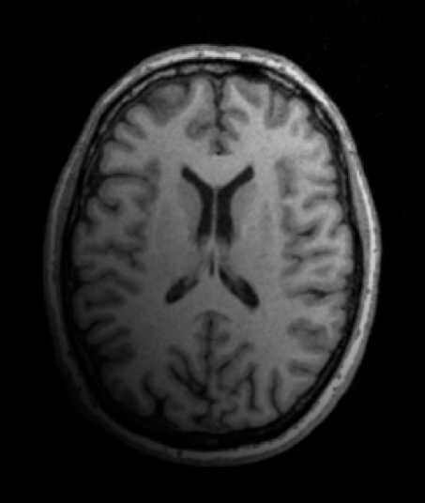
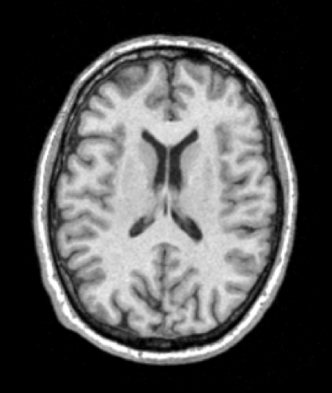
Preprocessing: Bias Field Correction
Used FSL-FAST* for bias field correction
FSL FAST
* S. Smith, HUM. BRAIN MAPP., 2002
Notes:
It is usually observed that there is a bias field in the images that means there is some kind of intensity inhemogeniety in different locations of the same image.
So FSL-FAST was used to do the correction.

Slide 14
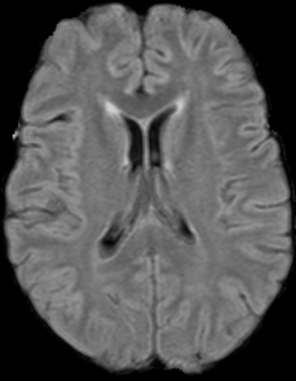
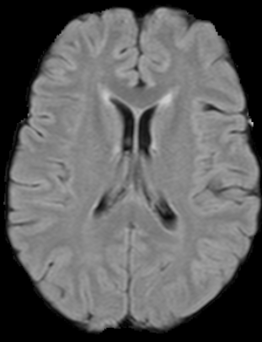
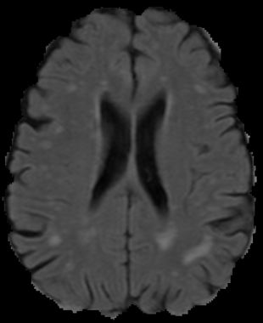
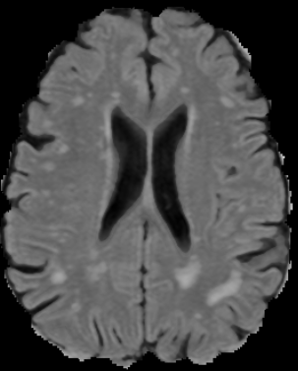
Preprocessing: Standardization
Possibility of inter-subject intensity variability
Standardization:
Gaussian Mixture Modeling for 3 brain tissues (GM, WM, CSF)
Fuzzy intensity transformation of each voxel based on it’s degree of membership to each tissue
Notes:
Even after bias field correction, it is still very probable that we have intensity inhemogeniety among different subjects, as you see in the two images here.
So we used Gaussian Mixture Modeling to extract 3 brain tissues, which are GM, WM and CSF. (Expectation Maximization has been used for GMM)
Then each voxel intensity is transformed in a fuzzy way based on it’s degree of membership to each tissue.

Slide 15
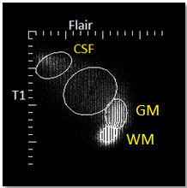
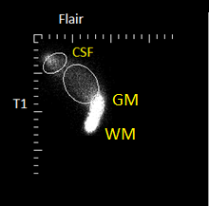
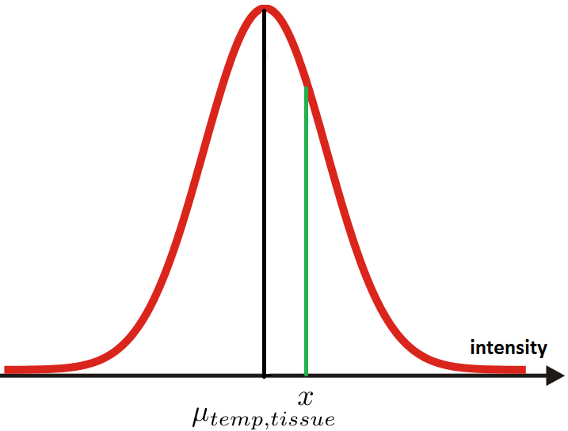
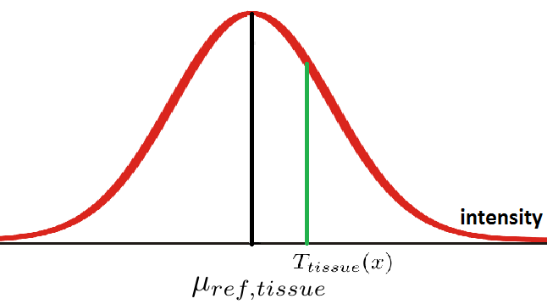
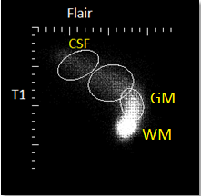
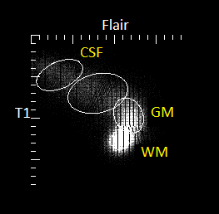
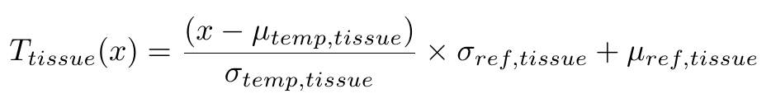
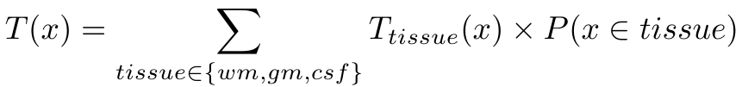
Preprocessing: Intensity Standardization
Notes:
Here we see more details about this process: first we assuming that an intensity X belongs to a specific tissue, we calculate the transformed intensity in the corresponding tissue and then using the belonging probabilities to different tissues, we calculate a weighted average over the 3 possible transformations.

Slide 16
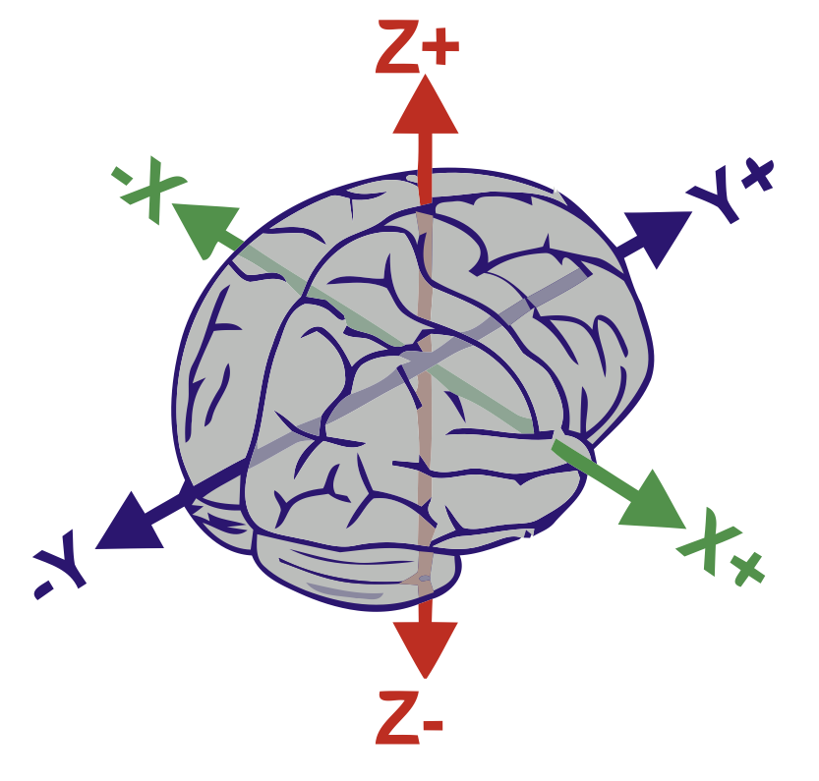
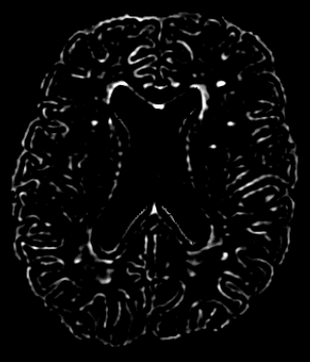

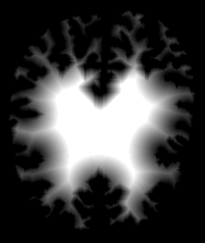
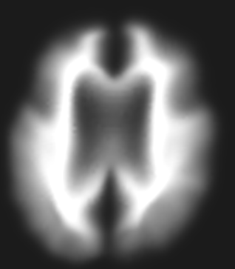
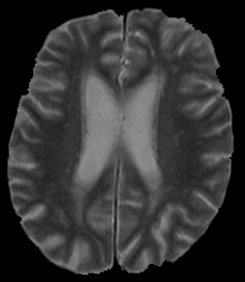
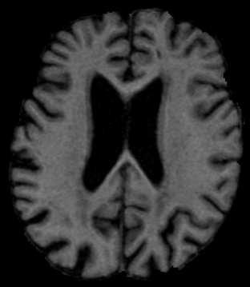
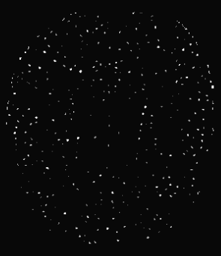
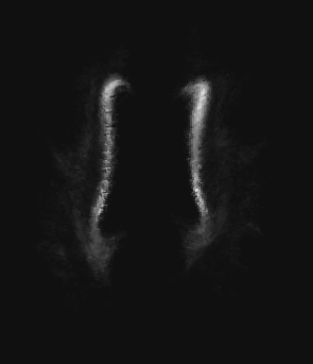
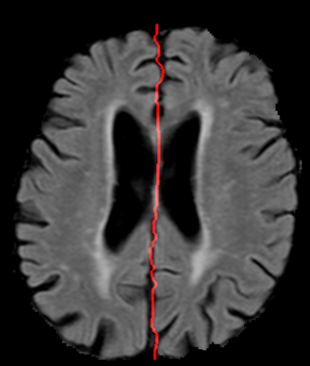
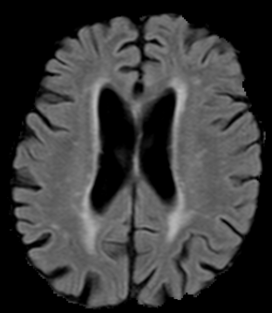
Features
Intensities
FLAIR
T1
T2*
Location
X, Y, Z in the MNI space
Distances from
Brain surface
Left & right ventricles
Midsagittal brain surface
Prior probability based on location
Tissue probabilities
WM probability
GM probability
CSF probability
Second order derivatives
Multiscale Laplacian of Guassian
Multiscale determinant of Hessian matrix
Vesselness
Multiscale grayscale annular filter
Notes:
Then we start calculating the features. Some of the features that are used are listed here:
Intensities are the most trivial features one can think of for this task.
Since we already know that white matter lesions are not uniformly distributed among different locations of the brain, we calculate several features to capture this.
X, Y and Z coordinates of the corresponding voxel in the MNI space.
Voxel distances from
Brain surface,
left and right ventricles
midsagittal brain surface (that separates the two hemispheres and we calculated that using a dynamic programming approach)
and Since we had a large dataset a pretty accurate location based prior probability of WMLs could be acquired as a valuable feature.
Since wmls occur on the white matter of the brian, we used the tissue probability maps acquired from registration of tissue atlases.
We also made use of several second order derivative features including multiscale log and doh and vesselness to distinguish between vessel like
structure in gm and small wmls

Slide 17
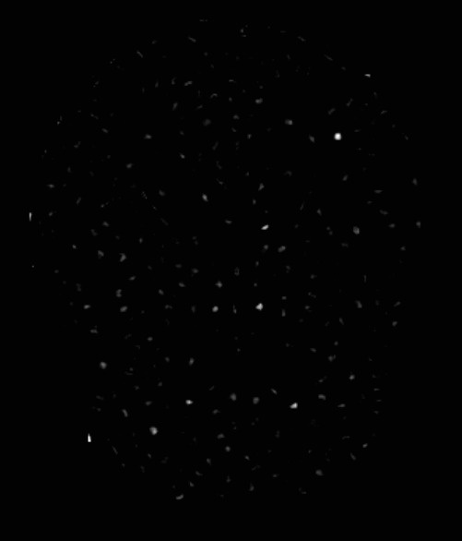
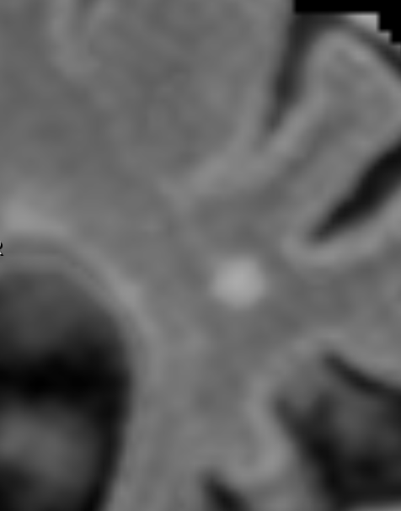
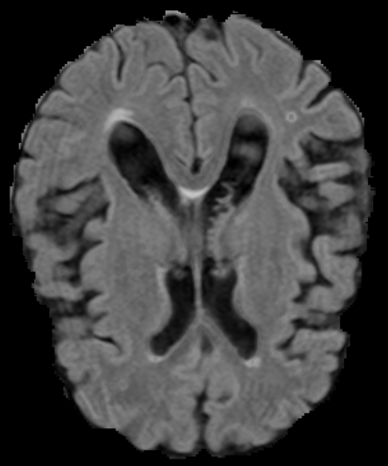
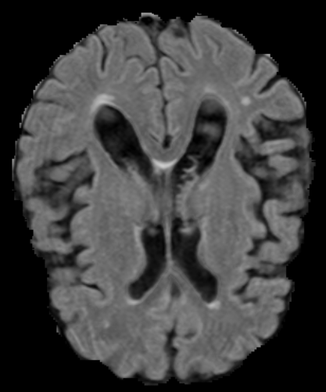
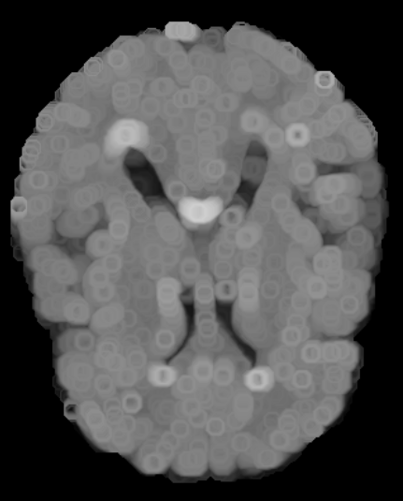
Annular Filter
Notes:
But in fact I am personally more interested in another blobness detector which is far less famous. (the paper has only got 8 citation!!)
Officially it is named “Annular Filter” but I tend to call it “Donut Filter”!
Like most other image processing filters it consists of a kernel scanning the whole image, and on each spot it is on, we first calculate the maximum of intensities on the kernel (of course excluding the central part) and then replacing the center of kernel with the maximum.
So let’s see what happens if the kernel goes on top of a blob like structure: because all the voxles around the blob is darker than the central part, the bright center point is replaced by a lower intensity.
But if it is placed on a vessel like structure, the maximum will be a high intensity value like the central part, so nothing is changed drastically.
So this will be the result of this calculation. we have a new image in which the blob (at least blob centers) are disappeared, but there are some donut shape artifacts also visible on the image. So where they come from?
Let’s investigate: for all points that the kernel goes over the blob, the maximum which will replace the center will be with high value. So the geometric location of all these centers (which is circle itself) will be bright.
To get rid of this effect we calculate the voxel-wise minimum of the resulted and original image and as the result we will have something very similar to image which only has it’s blobs removed!
So finally if we subtract the result form the original image, we will come up with the description of blobs, as you see here!

Slide 18
Supervised Learning: Sampling
100 randomly selected images
Positive:
All voxels in lesions with effective diameter < 3 mm
Negative:
Removal of trivial samples (dark voxels)
2% of the remaining.
Ignore:
Large lesion samples left out
Notes:
One important note in the sampling process is that we left over the large lesion samples form small WML training set and vice versa, so that the classifiers do not get confused.
We used Random Forrest as a nice and strong classifier
And on top of that 5 iterations of adaboost was performed.
In adaboost we have a separate classifier in each iteration and the samples which were wrongly classified in previous iterations get higher probability to be selected
And thus we have more concentration on harder sample. This seems to be mandatory specially for small white matter lesions detection, which is a very tough concept to learn due to noises which look like similar to small WMLs.

Slide 19
Supervised Learning: Learning Method
Classifier:
Random forest
Usage of 3 iterations of Adaboost
Higher selection probability for samples misclassified in previous iteration
More concentration on hard samples
Notes:
One important note in the sampling process is that we left over the large lesion samples form small WML training set and vice versa, so that the classifiers do not get confused.
We used Random Forrest as a nice and strong classifier
And on top of that 5 iterations of adaboost was performed.
In adaboost we have a separate classifier in each iteration and the samples which were wrongly classified in previous iterations get higher probability to be selected
And thus we have more concentration on harder sample. This seems to be mandatory specially for small white matter lesions detection, which is a very tough concept to learn due to noises which look like similar to small WMLs.

Slide 20
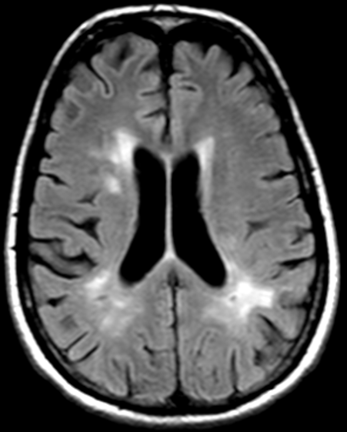
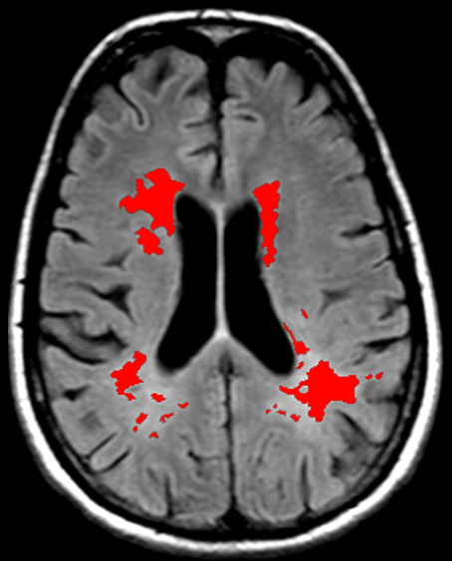
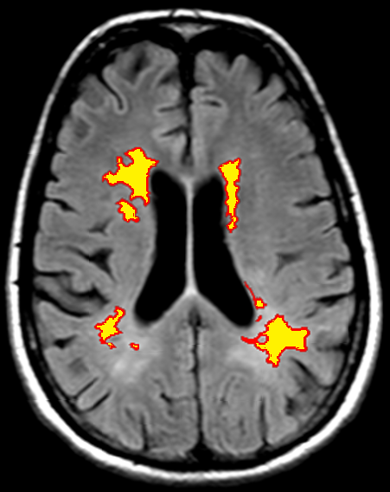
Evaluation Method
Notes:
It extremely important that what you consider for your evaluation criteria, since a method is then can be seen as an optimization process on that criteria.
Unlike most of the methods we avoid using DICE coefficient or voxel based ROC, since then as you see most of small lesions go undetected.
There is mainly two reason for this: first the smaller the lesion is the less it contributes to those target functions. And also it is case that they are much harder to be detected.
For these reasons we make use of an FROC analysis that does not care about the number of voxels being detected, but reflects the number of lesions being correctly detected, regardless of how big or small they are.

Slide 21
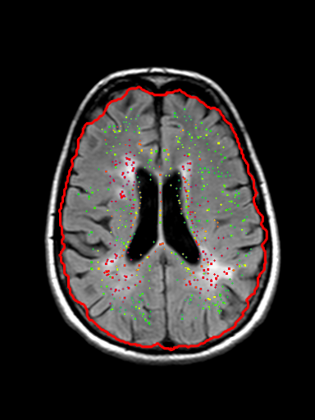
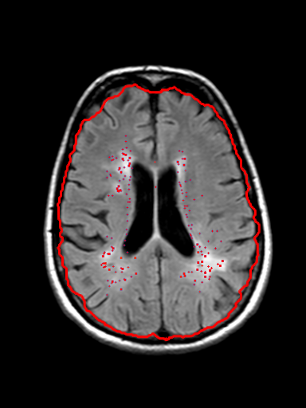
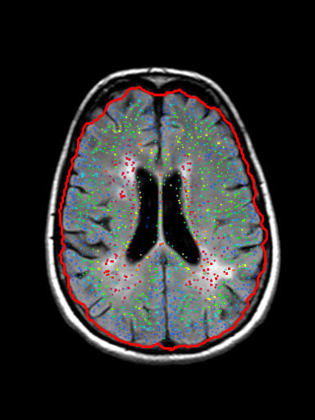
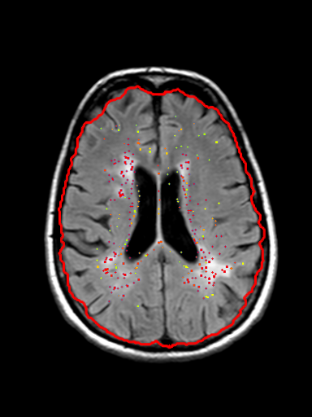
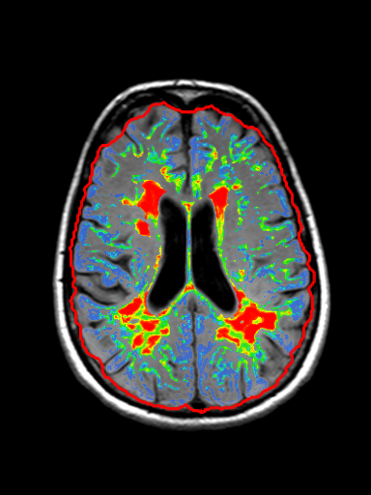
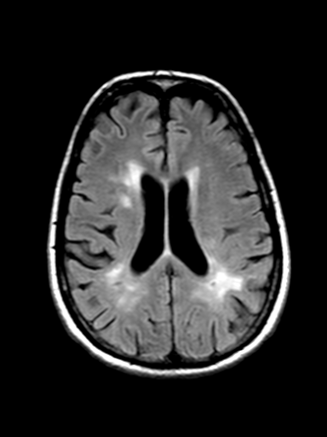
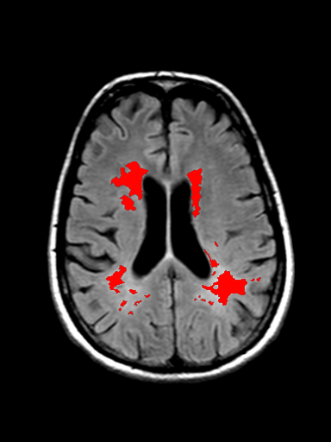
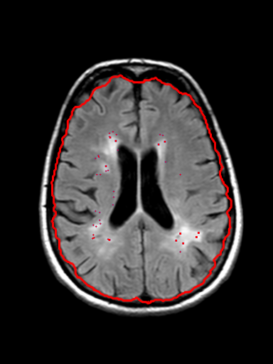
Evaluation Method (FROC)
Threshold > 0.00
Threshold > 0.90
Threshold > 0.99
Threshold > 0.97
Threshold > 0.95
Local Maxima
FLAIR
Annotations
Likelihood Map
Notes:
The detail of the evaluation method is shown in this diagram:
First of all form the probability map provided by the classifier, we

Slide 22

Results: FROC (Different Classifiers)

Slide 23

Results: FROC (Different Feature Sets)
I: Intensities
T: tissue probabilities
L: Location features
S: Second order derivatives
A: Annular filter
Notes:
But because we are more interested in detection quality here you see a FROC curve for the two classifiers, both of them tested with both of the two human experts as the ground truth.
There are something to be noted here:
first we have better results using second annotator as the GT. So it seems like that he is doing a more similar job in detecting the lesions
and second and more importantly, we have got two systems with different characteristics, that each of them can cover the downsides of the other one.
if we want the system to work with high tpr, adaboost is the better option because it has more concentration on for example 20% hard positives
if low number of false positives matter more for us, then SVM would be the way to go.

Slide 24


Visualized Results
Original FLAIR
Reference Standard
CAD system detection
Notes:
But because we are more interested in detection quality here you see a FROC curve for the two classifiers, both of them tested with both of the two human experts as the ground truth.
There are something to be noted here:
first we have better results using second annotator as the GT. So it seems like that he is doing a more similar job in detecting the lesions
and second and more importantly, we have got two systems with different characteristics, that each of them can cover the downsides of the other one.
if we want the system to work with high tpr, adaboost is the better option because it has more concentration on for example 20% hard positives
if low number of false positives matter more for us, then SVM would be the way to go.

Slide 25

Visualized Results
Original FLAIR
Reference Standard
CAD system detection
Notes:
But because we are more interested in detection quality here you see a FROC curve for the two classifiers, both of them tested with both of the two human experts as the ground truth.
There are something to be noted here:
first we have better results using second annotator as the GT. So it seems like that he is doing a more similar job in detecting the lesions
and second and more importantly, we have got two systems with different characteristics, that each of them can cover the downsides of the other one.
if we want the system to work with high tpr, adaboost is the better option because it has more concentration on for example 20% hard positives
if low number of false positives matter more for us, then SVM would be the way to go.

Slide 26

Discussion and Conclusions
Detection of small WMLs is a challenging task.
Partial volume effect
Dirty white matter
Patient movement artifact and noises
Contribution of features
Location information
Annular filter
Contribution of classifier
Adaboost

Slide 27
Thanks!

Slide 28

Extra Slide – Future Work
Specifying another classifier on larger lesions
Train a second stage classifier on the likelihoods provided by the two size specific classifiers
Performs better than a single stage classifier!

